Slide 1
Front End Engineering-I Project
Team Details:
Anterpreet Kaur (2310991614)
Anuj Maurya (231991615)
Anusha Jindal (2310991616)
Faculty Coordinator:
Dr. Mohammad Shuaib Khan
:
Chitkara University Institute of Engineering and Technology,
Chitkara University, Punjab

Slide 2
Table of Contents
Introduction
Problem Statement
Technical Details
Key Features
Project Highlights
Conclusion
References/Links used

Slide 3
Introduction
Topic:
Quizzard: An interactive quiz platform
Team members:
Anterpreet Kaur (2310991614)
Anuj Maurya (2310991615)
Anusha Jindal (2310991616)
Project Overview:
This project involves creating an interactive quiz that engages users with questions and multiple-choice answers. Through HTML, CSS, and JavaScript, the quiz will offer an enjoyable and educational experience. Users can test their knowledge on various topics while receiving instant feedback on their performance.

Slide 4
Problem Statement
Problem Statement and Background
Problem:
Educational engagement is a pressing concern in modern learning environments. Traditional methods often lack interactivity, leading to reduced knowledge retention and learner disinterest. To address this issue, we've undertaken a project to develop an interactive quiz system.
Background:
Traditional exams struggle to adapt to diverse learning styles and hinder inclusivity. The rise of online and remote learning has exposed the limitations of conventional assessment methods. There's a pressing need for a dynamic quiz platform to address these challenges. Technology offers an opportunity to revolutionize assessments by providing instant feedback and accommodating diverse needs. Modern education requires assessments that can measure practical application and critical thinking. A sophisticated quiz platform can align with global trends, accommodating hybrid learning models. Insights from analytics empower educators to tailor teaching methods effectively. The platform can enhance student engagement through interactive and gamified experiences. Motivating elements, such as instant feedback and rewards, contribute to an improved learning experience. Ultimately, the quiz platform addresses the evolving landscape of education.

Slide 5
Technical Details
Technologies and Methods Overview
Technologies Used:
1. HTML: The foundation of our project, HTML, is used for structuring and organizing the quiz content.
2. CSS: Cascading Style Sheets (CSS) are employed to design an intuitive and visually appealing user interface, ensuring a seamless user experience.
3. JavaScript: JavaScript is used to add interactivity and functionality to the quiz, such as real-time scoring, timer functionality, and dynamic feedback.
4.VS Code: VS Code is a powerful and light weight source code editor developed by Microsoft offering robust features, a customizable interface, and a vast extension ecosystem, making it a favorite among developers for efficient coding workflows. All the code is written and debugged on visual studio code.
Methods and Approaches:
1. User-Centered Design : We follow a user-centered design approach to ensure the quiz is intuitive and engaging for our target audience.
2. Agile Development: Our project adopts Agile methodologies, allowing for iterative improvements and flexibility throughout the development process.
3. Responsive Design: Using responsive design principles, the quiz adapts seamlessly to various screen sizes, including mobile devices, tablets, and desktops.

Slide 6
Key Features
Key Features:
1. Interactive Questioning : Engage users with interactive questions that require active participation.
2. Multiple Question Types: Provide various question formats, including multiple-choice, true/false, and fill-in-the-blank, to cater to different learning styles.
3. Instant Feedback: Offer immediate feedback for each question to reinforce learning and correct misconceptions.
4. Scoring and Progress Tracking : Implement scoring mechanisms to track user progress and motivate continued participation.

Slide 7
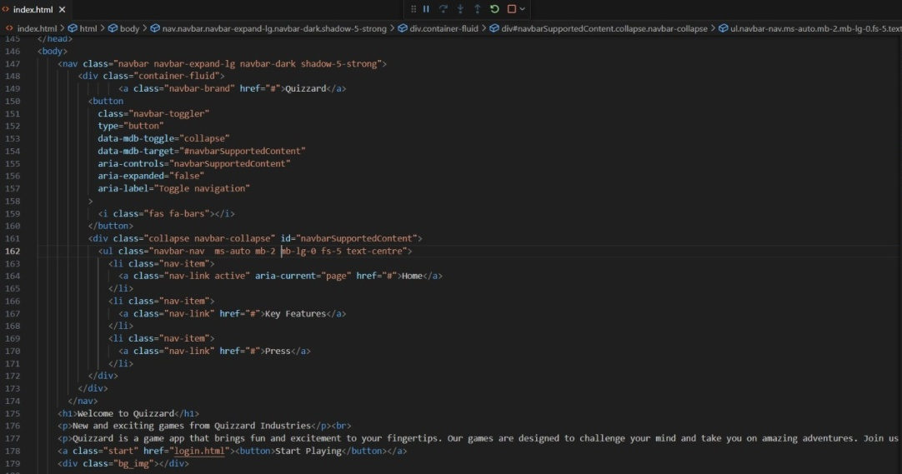

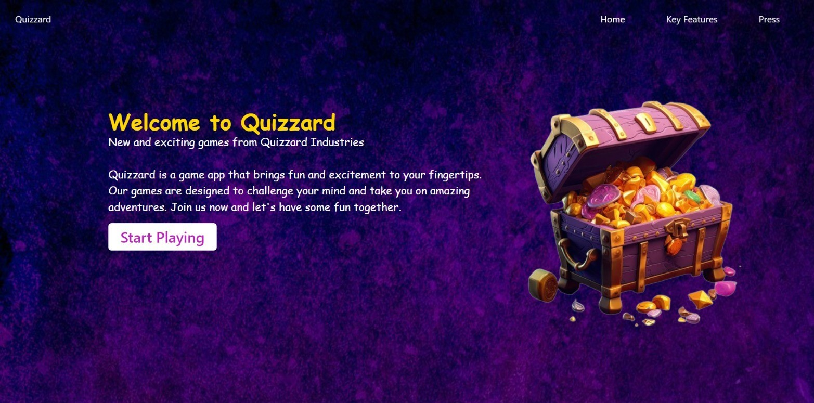
Project Highlights

Slide 8
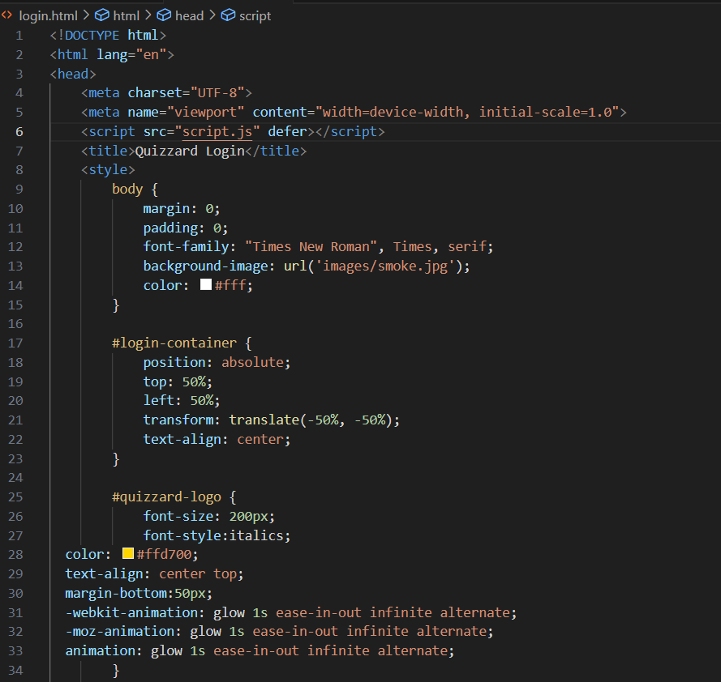
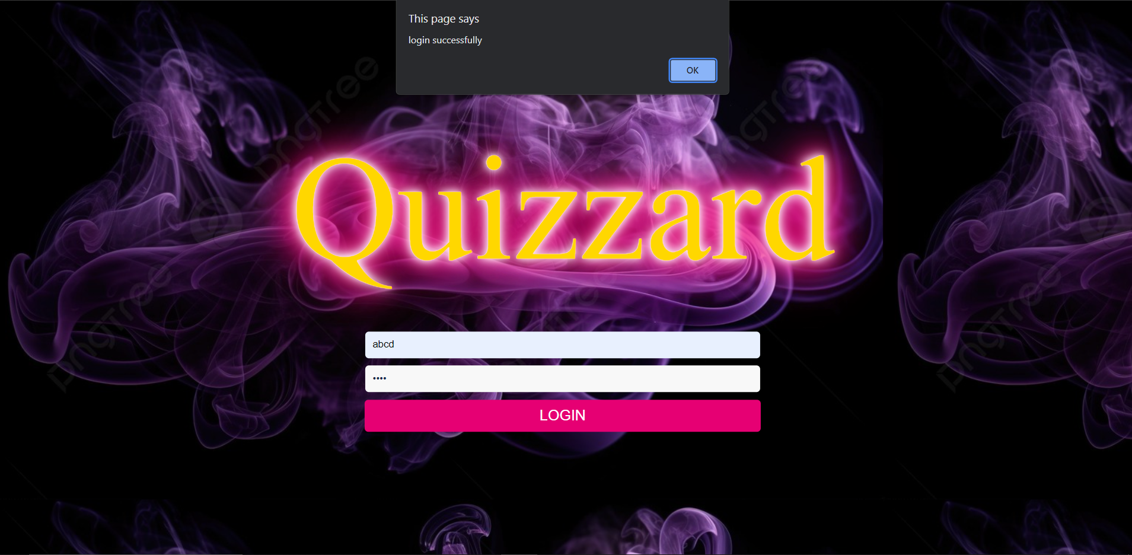

Slide 9
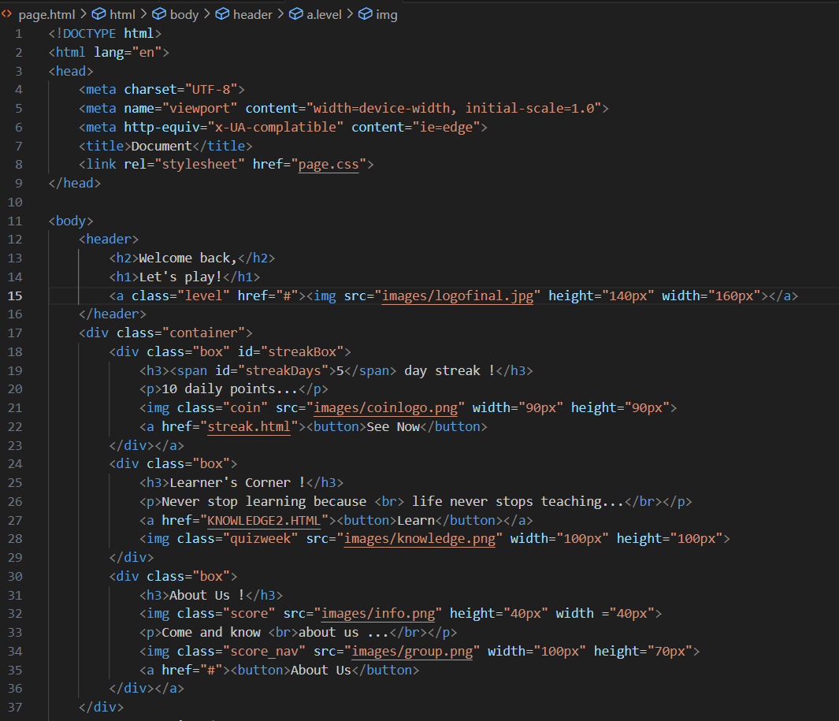
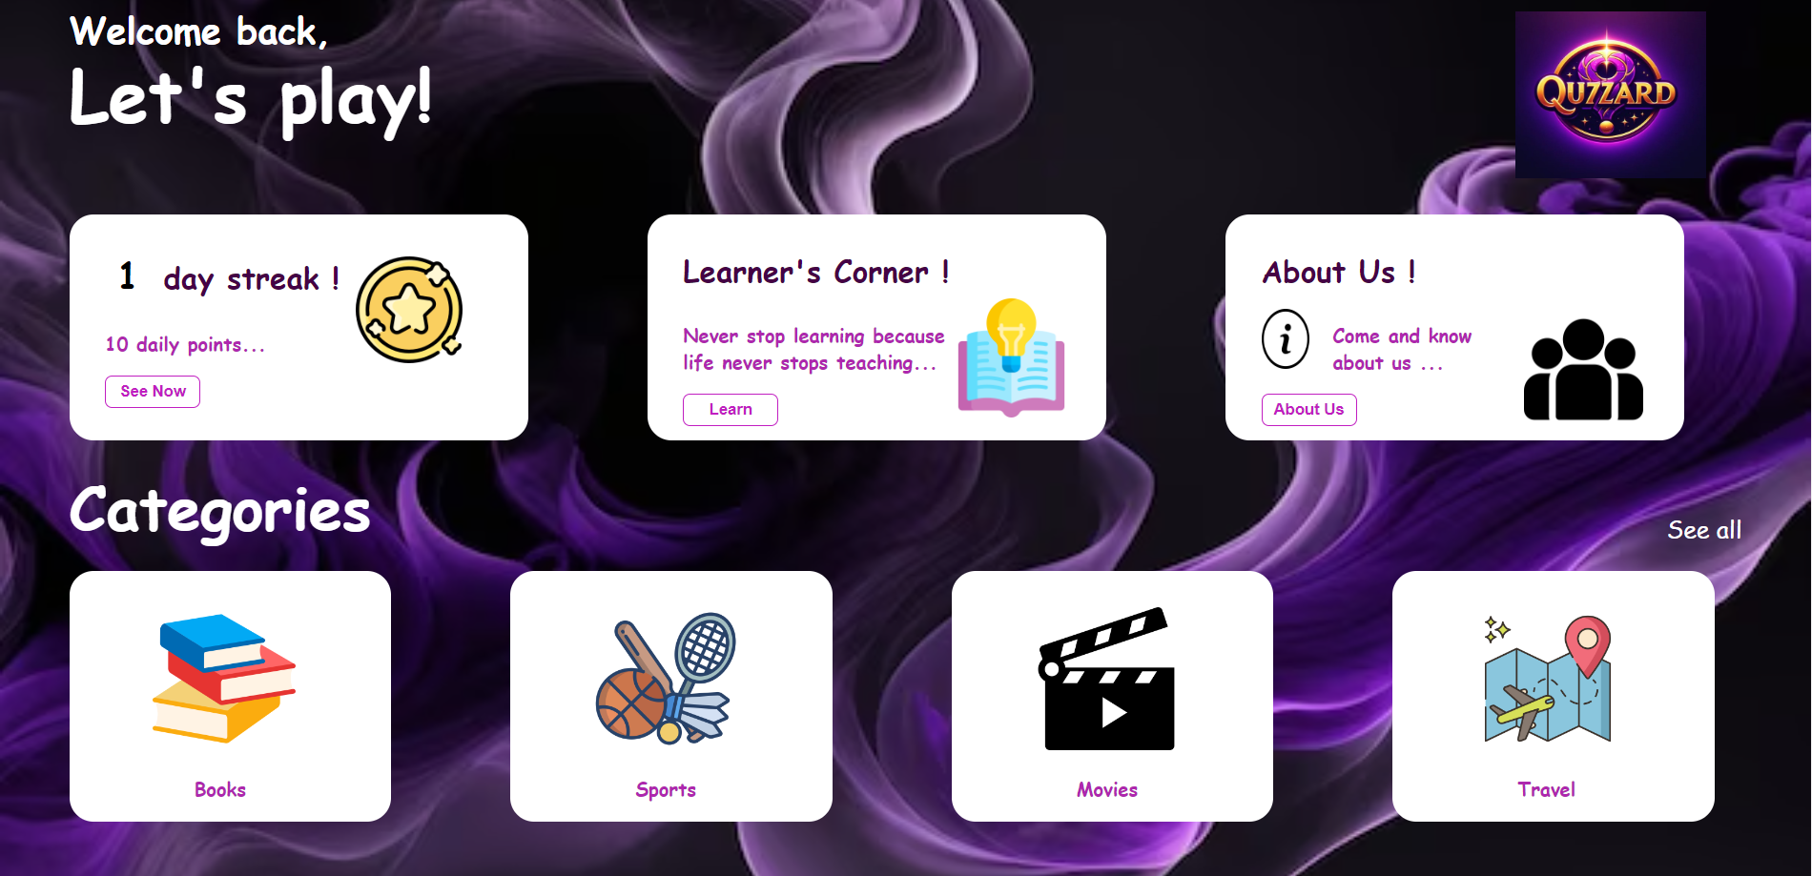

Slide 10
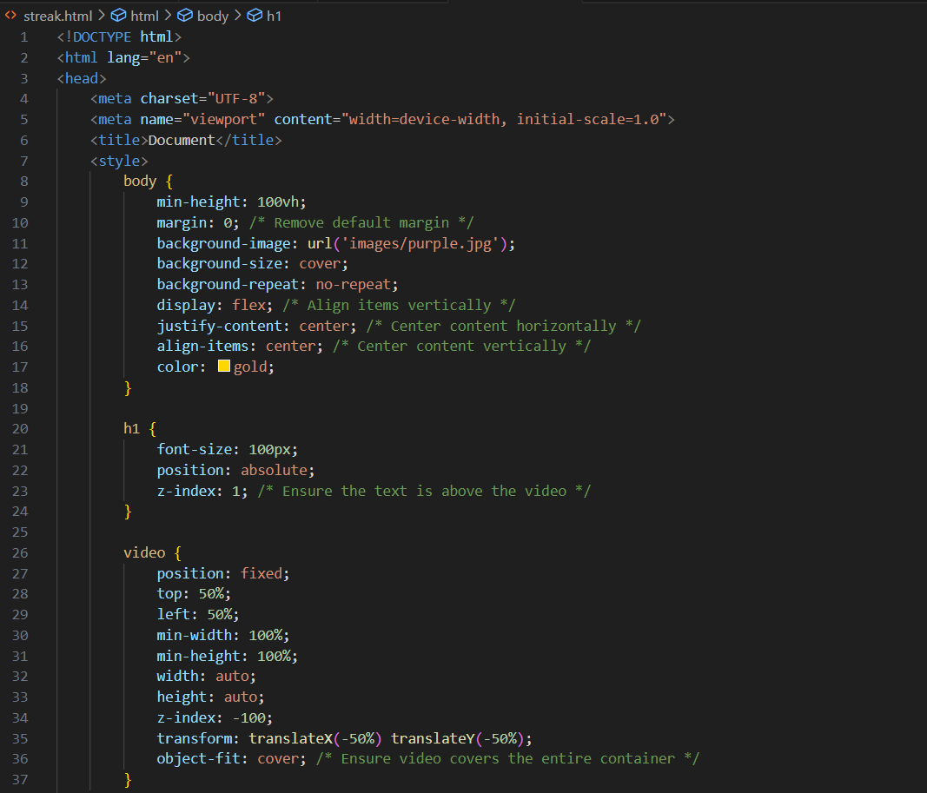


Slide 11
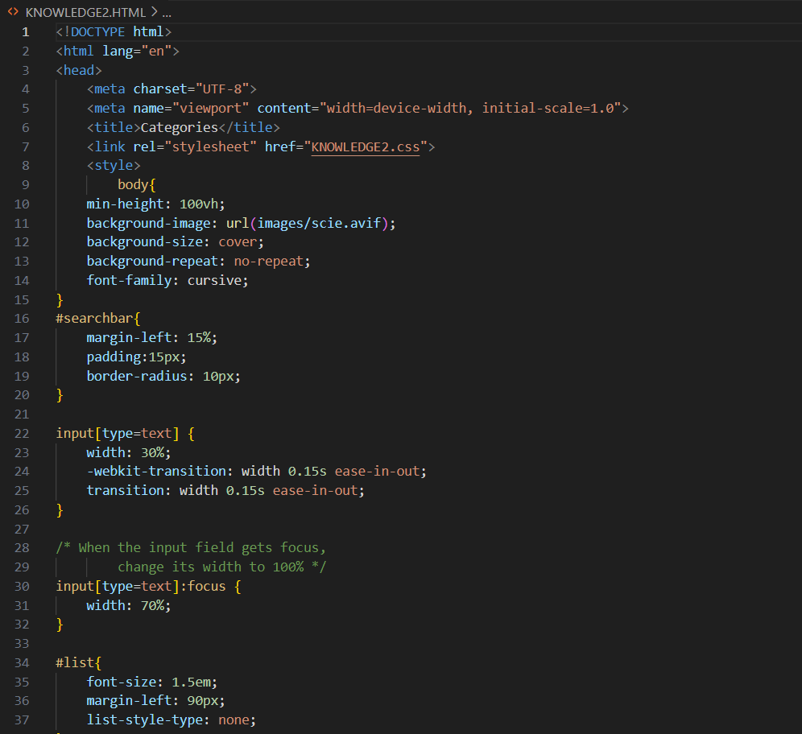
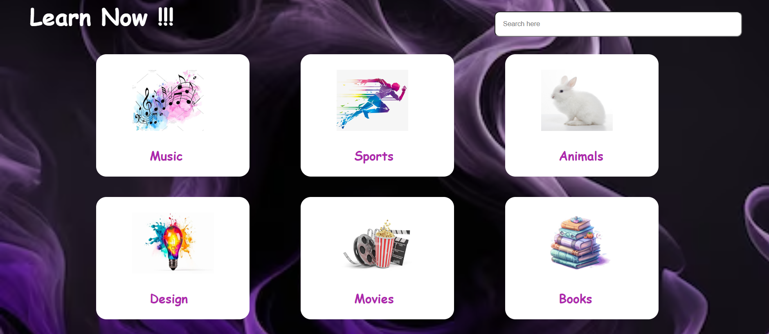

Slide 12
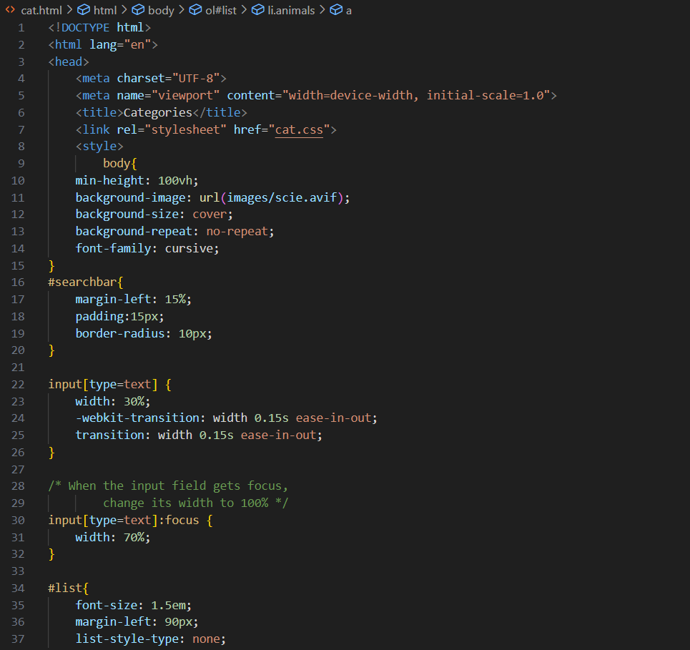
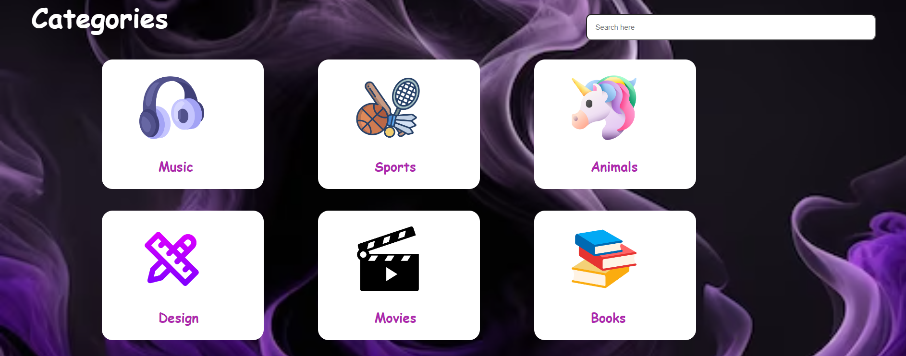

Slide 13
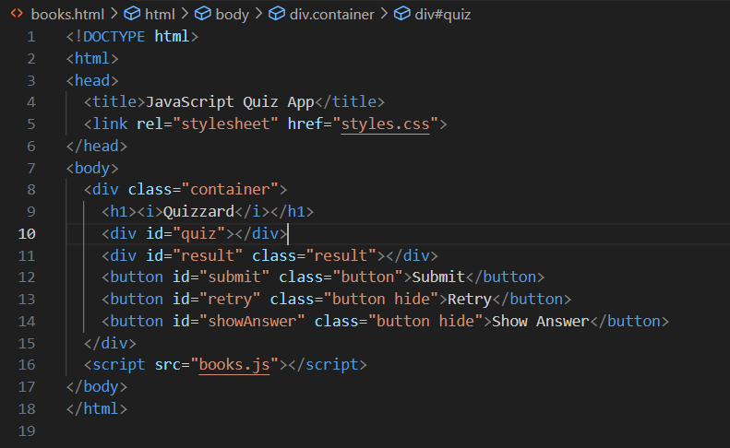
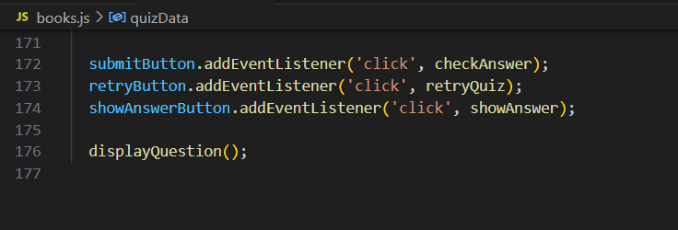
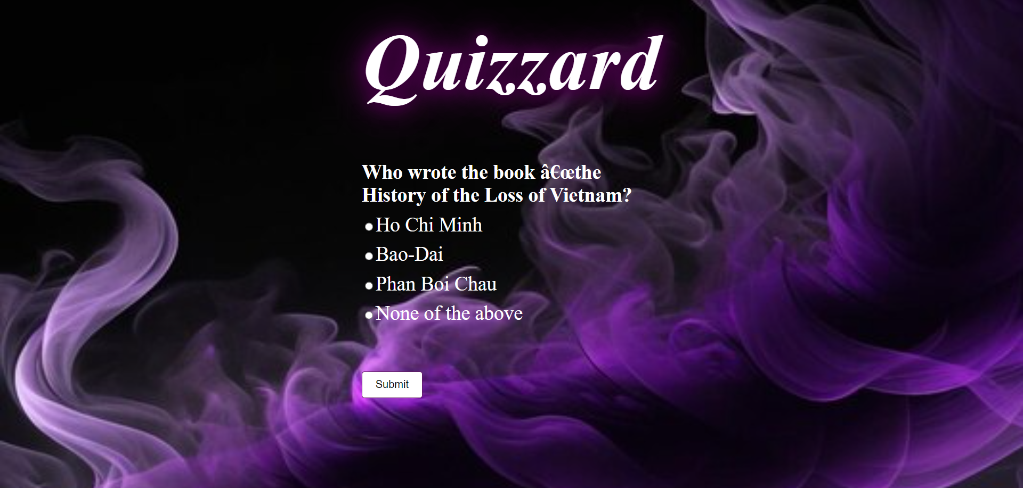

Slide 14
Conclusion
Project Summary:
Objective: Our project aimed to enhance educational engagement by developing an interactive quiz platform.
Technologies: We utilized HTML, CSS, and JavaScript to create an interactive and user-friendly quiz experience.
Key Features: Our quiz offers interactivity, multiple question types, instant feedback, scoring, customization, and accessibility.
Results: The project successfully addresses the engagement problem and fosters active learning through quizzes.
Main Take aways:
1. Engagement Matters: Interactive elements significantly improve user engagement and knowledge retention.
2. Continuous Improvement : Agile development allowed us to adapt and enhance the quiz based on user feedback and evolving needs.
3. Accessibility is Key: Prioritizing accessibility ensures inclusivity and widens the reach of our educational tool.
4. Data-Driven Insights: Collecting user data provided valuable insights for future enhancements and customization.
5. Team Collaboration: Effective collaboration among team members was crucial for project success.

Slide 15
References/Links used
References used:
CANVA
EDX
EDMUNDS
ESPN
GOOGLE
HISTORY
IMDB
SPORCLE
SPOTIFY
W3SCHOOLS
WIKIPEDIA

Slide 16


